Slide 1
Occupational health and safety of teachers, academics and other education personnel in times of COVID-19

Slide 2
Research objectives
A quick scan of the OSH conditions of the teachers, academics and other education personnel in the member organisations of ETUCE
Vaccination
Prioritization of education sector as a target group
Differences in prioritization within the target group
School closures
Are schools closed or (partially) open?
Differences in education levels?
Support offered: on site/in online teaching?
Good practices

Slide 3
Quick scan
Short online survey in all member organisations of ETUCE 10 questions
Completed with desk research
1 week: 22 – 26 March
Snapshot - Situation is changing rapidly

Slide 4
Survey replies as basis for analysis
67 replies (online/e-mail/phone) in 40 countries
40 countries
Albania | France | Luxembourg | Russian Federation
Armenia | Georgia | Macedonia | Serbia
Belgium (Flanders) | Germany | Malta | Slovakia
Bulgaria | Greece | Moldova | Slovenia
Croatia | Hungary | Montenegro | Spain
Cyprus & Northern Cyprus | Iceland | Netherlands | Sweden
Czech Republic | Ireland | Norway | Switzerland
Denmark | Israel | Poland | Tajikistan
Estonia | Italy | Portugal | UK
Finland | Lithuania | Romania | Ukraine

Slide 5
Vaccination: prioritization of teachers, academics and other education personnel
1

Slide 6
UNICEF is calling for teachers to be prioritized to receive the COVID-19 vaccine, once frontline health personnel and high-risk populations are vaccinated. This will help protect teachers from the virus, allow them to teach in person, and ultimately keep schools open.
UNICEF,
15 December 2020

Slide 7
Vaccination priority?

Slide 8
In which countries is education staff prioritized (© survey)?
Albania
Armenia
Bulgaria
Croatia
Czech Republic
Estonia
Georgia
Germany
Iceland
Israel
Italy
Lithuania
Malta
Poland
Portugal
Romania
Serbia
Slovakia
Slovenia
Spain
Ukraine
Belgium = May?

Slide 9
Does the prioritization apply to all education staff?

Slide 10
Prioritization of certain groups
Education level
40% of the respondents mention a subprioritization based on the education level
Most often vaccinated = early childhood education teachers;
Least often vaccinated = higher education teachers/academics
-> linked to school closures
Vulnerable groups
Special needs schools
Vaccination based on age/underlying health problems, no relation to profession

Slide 11
Vaccination & prioritisation strategies in the EU/EEA (ECDC, Dec 20)
Another primary group that can be considered for prioritisation for vaccination is essential workers, who are considered critical for maintaining societal functioning.
This could include social care workers, frontline workers, teachers, childcare providers, transportation workers and food and essential goods retail workers.
Reducing infection and sickness within these groups allows these workers to continue providing services to the general population (…)
https://www.ecdc.europa.eu/sites/default/files/documents/COVID-19-vaccination-and-prioritisation-strategies.pdf

Slide 12
Vaccination strategies and plans (ECDC, Feb 21)
Countries primarily prioritised elderly people (with various lower age cut-off across countries), residents and personnel in long-term care facilities, healthcare workers, social care personnel and those persons with certain comorbidities.
Some countries also prioritise workers of essential public services other than those in health such as police, firefighters and educational institutions workers.
https://www.ecdc.europa.eu/sites/default/files/documents/ Overview-of-COVID-19-vaccination-strategies-deployment-plans-in-the-EU-EEA.pdf

Slide 13
Prioritisation of COVID-19 vaccination © WHO, ECDC
The choice of optimal strategy depends on the objective:
reducing mortality, saving life years
reducing pressure on the healthcare system.
The most effective and efficient approach is to prioritise the vaccination of those groups at highest risk of severe disease and death

Slide 14
Arguments for prioritization of education staff
Educational staff and adults within the school setting are generally not seen to be at a higher risk of infection than other occupations […] (ECDC)
BUT:
“The effect of their vaccination is not only on teachers, however. Primary school classes include teachers and assistants, and if any are Covid-positive, the class quarantines (…); they are losing education experience. (Prof Joy Townsend, London School of Hygiene and Tropical Medicine, UK)
“Preventing a learning crisis from becoming a generational catastrophe requires urgent action from all. […] When education systems collapse, peace, prosperous and productive societies cannot be sustained.” (United Nations)

Slide 15
Inclusion of school and childcare staff on the priority list
Provides more protection for children and their families
Reduces the chance of settings being closed for weeks and working parents having to take time off work
Ensures continuity of education for children
Allows schools to return to normality faster, having a positive impact on children’s mental health
Reduces the chance of care workers having to stay at home with children who are isolated due to closures
“The consequences of extended missed or impaired education are steep, especially for the most marginalized. The longer children remain out of school, the less likely they are to return, and the more difficult it is for their parents to resume work” (UNICEF)

Slide 16
From physical health to mental health
Teachers have experienced higher levels of distress due to the workload generated during the lockdown.
Due to quarantines, prolonged and repeated closures of education institutions are taking a rising psycho-social toll on students, increasing learning losses and the risk of dropping out, disproportionately impacting the most vulnerable. (UNESCO)

Slide 17
School closures
2

Slide 18
Adverse consequences of school closures (UNESCO)
Confusion and stress for teachers
(…) teachers are often unsure of their obligations and how to maintain connections with students to support learning. Transitions to distance learning platforms tend to be messy and frustrating (…).
High economic costs
Working parents are more likely to miss work when schools close in order to take care of their children. This results in wage loss and tend to negatively impact productivity.
Increased pressure on schools and school systems that remain open
Localized school closures place burdens on schools as governments and parents alike redirect children to schools that remain open.

Slide 19
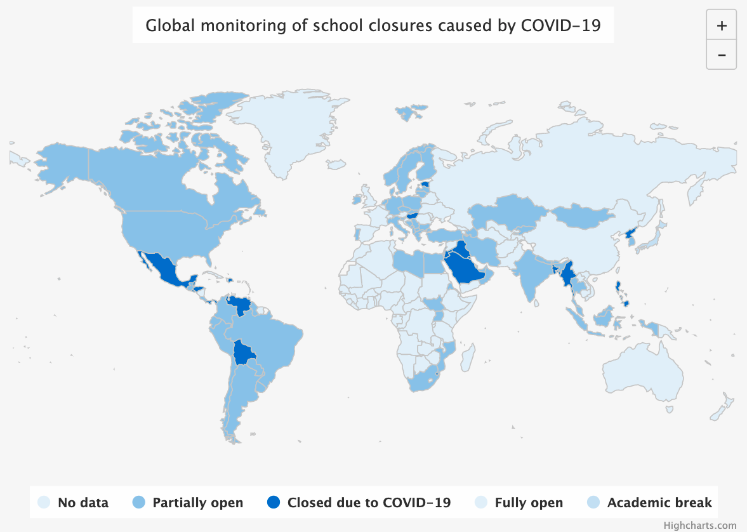
163,921,494 affected learners, 9.4% of total enrolled learners, 26 country-wide closures
UNESCO
26.03.2021

Slide 20
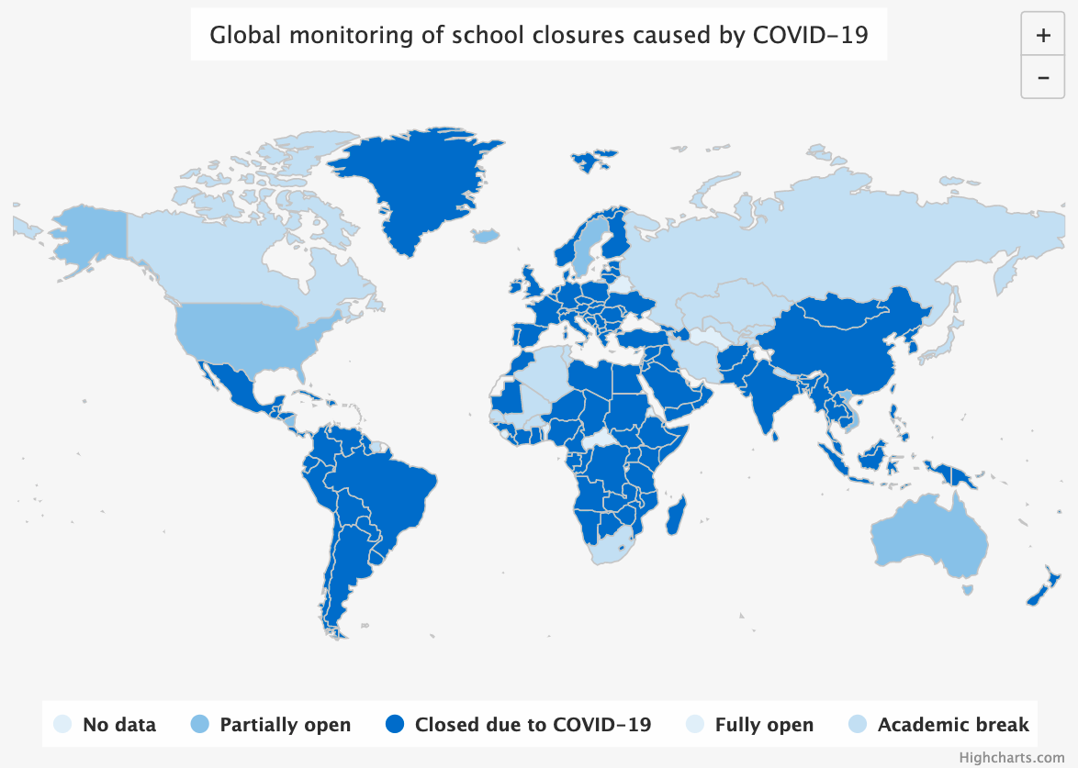
1,465,746,150 affected learners, 83.7% of total enrolled learners, 167 country-wide closures
UNESCO
26.03.2020

Slide 21
Are schools closed in your country?

Slide 22
School closures: desk research
Tendency 1: early childhood education = open
The younger the child, the smaller their role in spreading the coronavirus (RIVM, different studies)
In many countries, high quality remote learning for preschoolers has not been possible (UNICEF)
Preschools serve in the ability of parents to return back to work (UNICEF)
Early childhood advocates say kindergarten is a pivotal period that sets the stage for the rest of the elementary school years
Preschools and early childhood development centers are unique in their educational approach and are among the first to be considered for re-opening (United Nations)

Slide 23
School closures: desk research
Tendency 2: higher education/research = closed
Less contact hours
Older students are more likely to have IT equipment available
Higher education/research: dispose of more hardware & software since they belong to larger groups of merged educational institutions

Slide 24
What support is available?

Slide 25
Good practices
Moldova (Education and Science Trade Union Federation of Republic of Moldova)
The successful management of the pandemic situation between March 2020 and November 2020, in particular - the offer by the Minster of six options to restart the school year 2020-2021.
The decisions of the central government bodies to give the right to decide to local government bodies, including the management of kindergartens and schools - to establish the work regime based on the pandemic situation in the region
Denmark (DLF)
Sector partnerships (actors, ministry, Local Government Denmark). Close dialogue on weekly, daily basis

Slide 26
Good practices
Bulgaria (Bulgarian Union of Teachers SEB)
The effective social dialogue is one of the best good practices to protect the physical, psychosocial and mental health and well-being of those working in education. According to the National collective labour agreement of 2020, article 50 – teachers will be compensated for any expenses done during distance teaching. 10 days of paid leave were given to those recovering after Covid-19 sickness, to be used up to three month after recovery.
Iceland (KI)
Weekly meetings with the minister of education, including students. A good communication and consultation ensured that schools remained open, secondary education switched to online classes only at a certain point

Slide 27
Good practices
Sweden (Lärarförbundet, Swedish Teachers’ Union)
The Work Environment Authority has issued Systematic work environment management and risk assessment to prevent exposure to covid 19 especially designed for ECE. The Swedish National Agency for Education has created a Covid-19 Hub which gathers information on all aspects of Covid and Schools. Together with the National Public Health Agency they have also published guidelines for safe work in school, closure and opening of schools and safe distance teaching and learning.
Lithuania (LESTU) Free online e-textbooks on all subjects were provided for all

Slide 28
Good practices
UK (NASUWT)
The Teachers' Union produced a mental health awareness toolkit for use by members
Italy (Cisl) Psychological support within the school, for students and teachers

Slide 29
Good practices
Malta (Malta Union of Teachers MUT)
Schools adhered with rigid health protocols. Measures taken by schools exceeded by far the measures taken in general in other workplaces or in the community. This resulted in schools managing to continue to function face-to-face for more than five months
Poland (ZNP)
Large awareness raising campaign by ZNP, including letters to the central authorities, updates on social media every 3 hours, publishing information and articles on Covid-19, online and printed, weekly press conferences. Pressure resulted in effective measures

Slide 30
Good practices
UK (The Educational Institute of Scotland)
Risk assessments have been written with Trade Union input, joint Health & Safety inspections were carried out. Some local authorities have improved ventilation, hired extra staff and used CO2 monitors in classrooms.
Spain (UGT Unión General de Trabajadores)
The most effective measure has been the reduction of class sizes and the reinforcement, through the recruitment of more teachers, for students with educational needs.

Slide 31
What do the respondents need?

Slide 32
What do the respondents need?
Also asked for:
Right to disconnect (work-life balance)
Recognition for hard work in the frontline
Information and clear guidelines
Covid tests
Extra personnel
Reduced workload

Slide 33
Do not ask what our schools can do for you. Ask what you can do for our schools.
Belgian Ministers of Education

